Slide 1
MARRIAGES & DIVORCES IN SINGAPORE
Zheng Yimin / NSDAI -01 / P7053148

Slide 2
Contents page
Median ages of brides & grooms by marriage order
Median Age at First Marriage of Grooms and Brides by Educational Qualification, Annual
Total number of marriages by educational qualifications
Number of divorces from 1981 to 2020
Number of divorces by duration of marriage

Slide 3
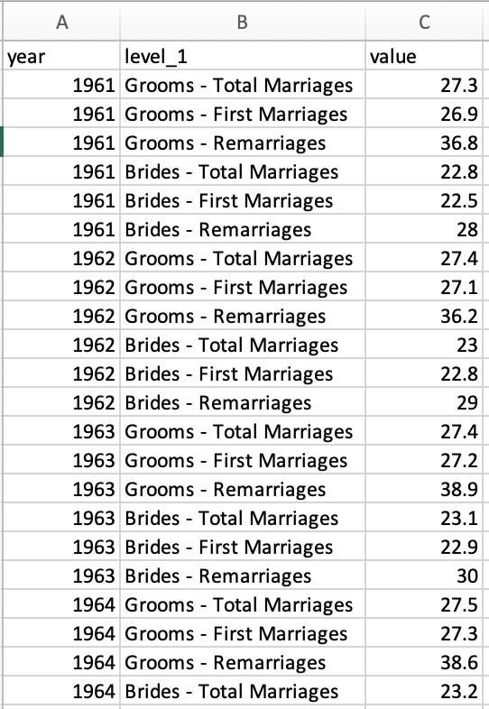
Median age of brides and grooms by Marriage Order
Link: https://data.gov.sg/dataset/median-age-of-grooms-and-brides-by-marriage-order-annual?view_id=fb571ca9-c1f5-4c8f-8dbe-bbcbedfcbbee&resource_id=f0cf2243-390d-4225-812a-262befc71293

Slide 4
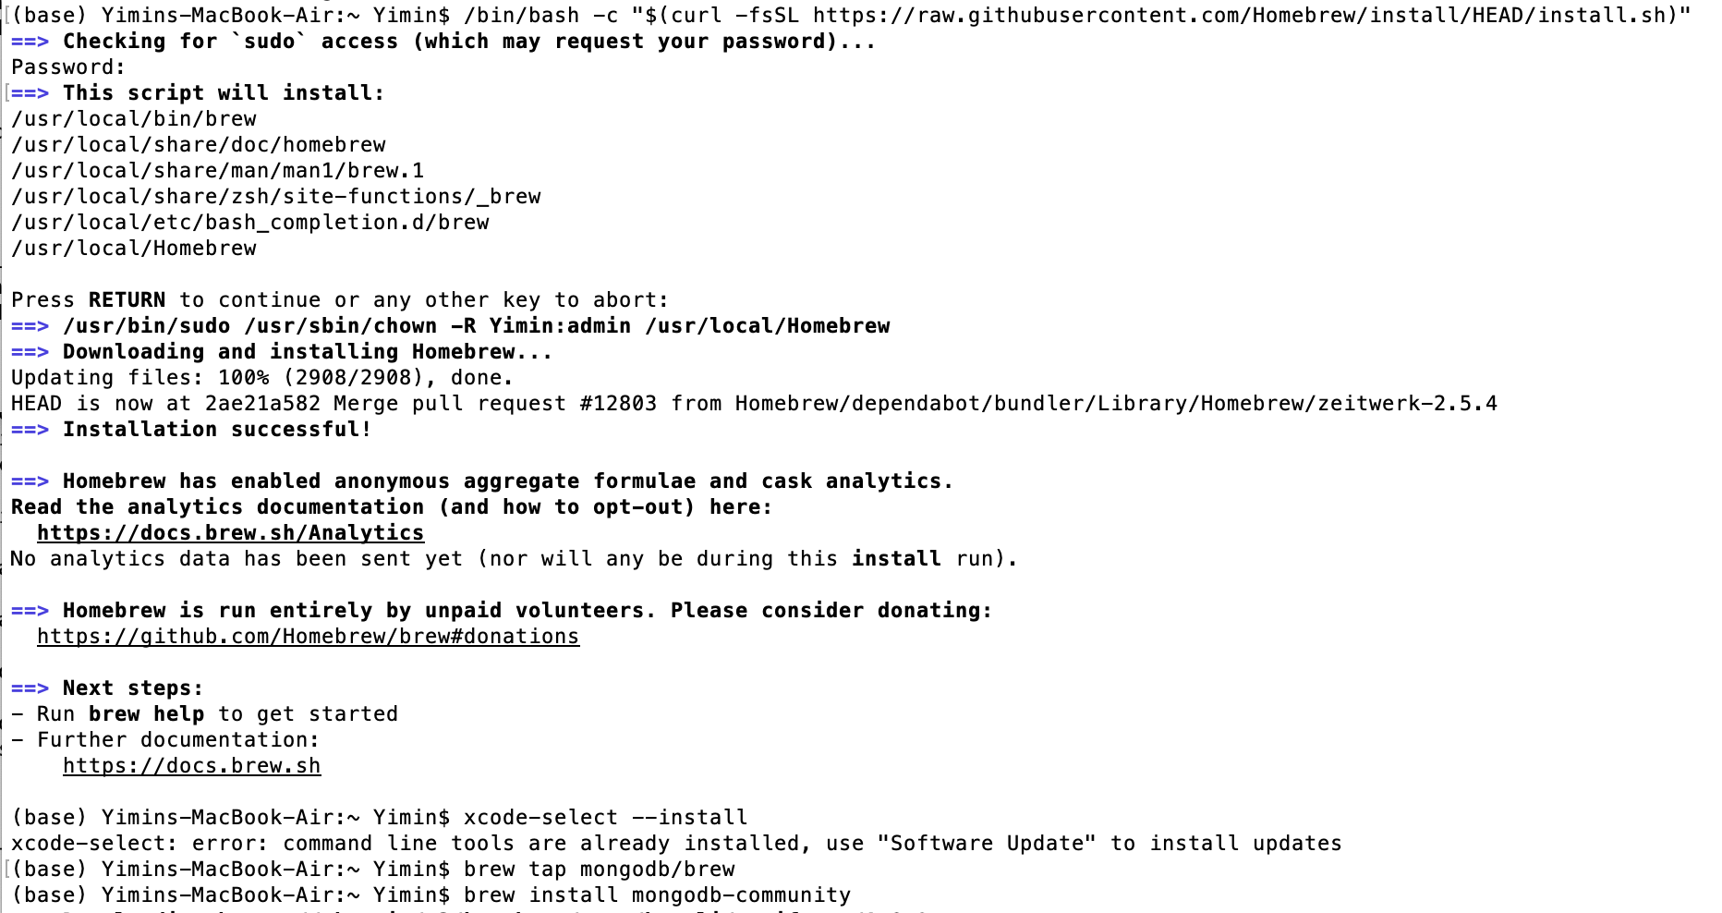
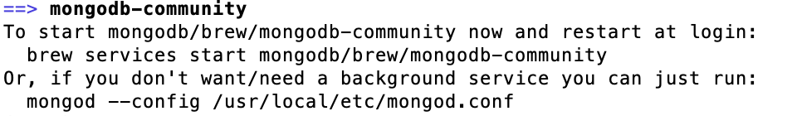
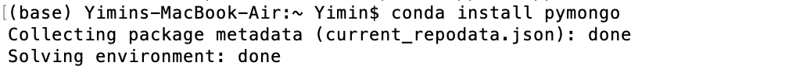
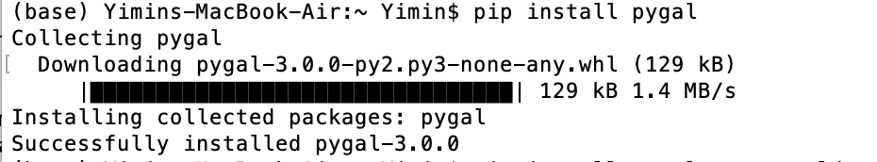
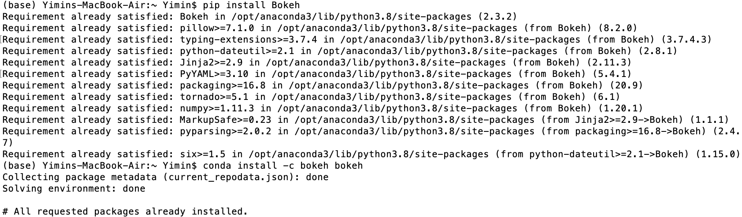
Median age of brides and grooms by Marriage Order
Step 1:
Installing MongoDB through terminal on Mac
Once MongoDB has been installed successfully, this message appears
Step 2:
Installing mongo on Anaconda
Step 3:
Installing Pygal and Bokeh packages on Anaconda using Mac’s terminal
Step 1
Step 2
Step 3

Slide 5
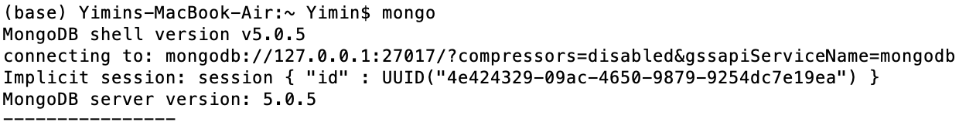
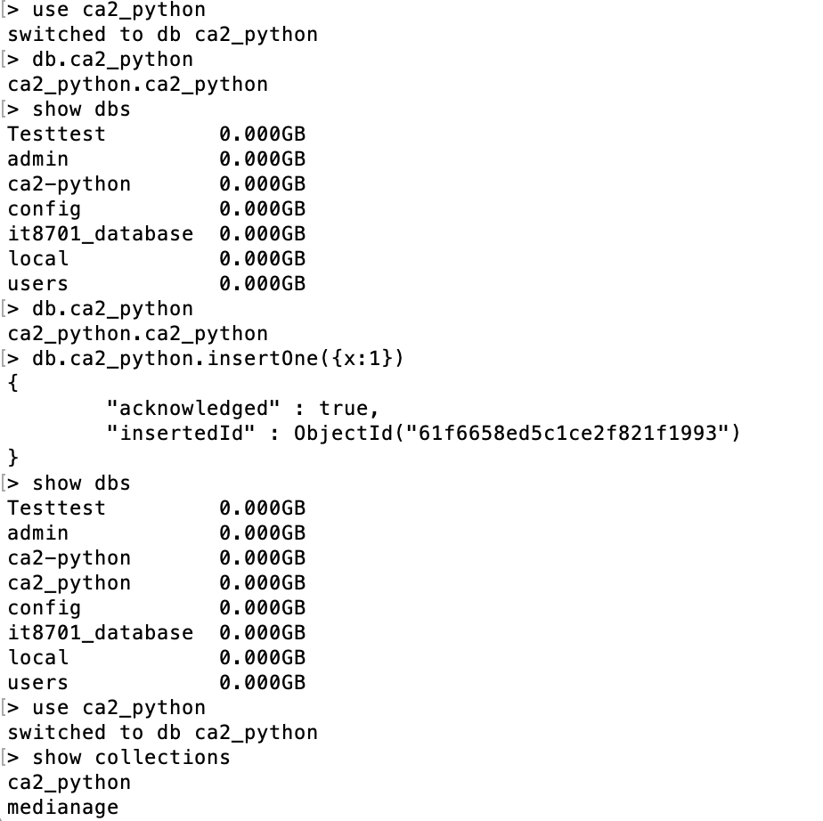
Median age of brides and grooms by Marriage Order
Step 4:
Importing dataset (in csv) into MongoDB terminal, by first launching the MongoDB terminal and create a database in the MongoDB terminal
Before creating database
After creating database
Step 4

Slide 6
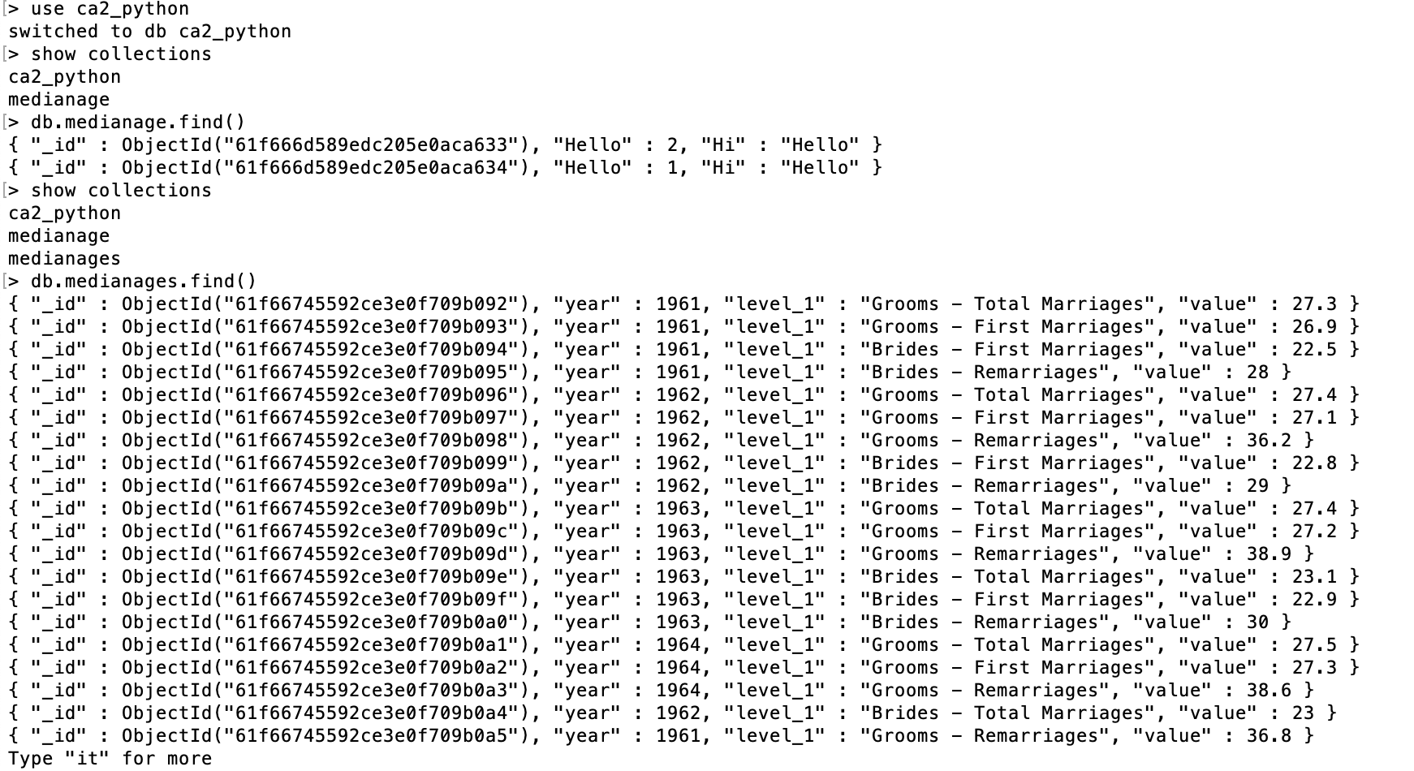
Median age of brides and grooms by Marriage Order
Step 5:
Import the file on the terminal, by specifying the fields – DB, Collection, Type, Headerline, Filepath
Step 6:
In the MongoDB terminal, populate the dataset by keying in the command on the right
Step 5
Step 6

Slide 7
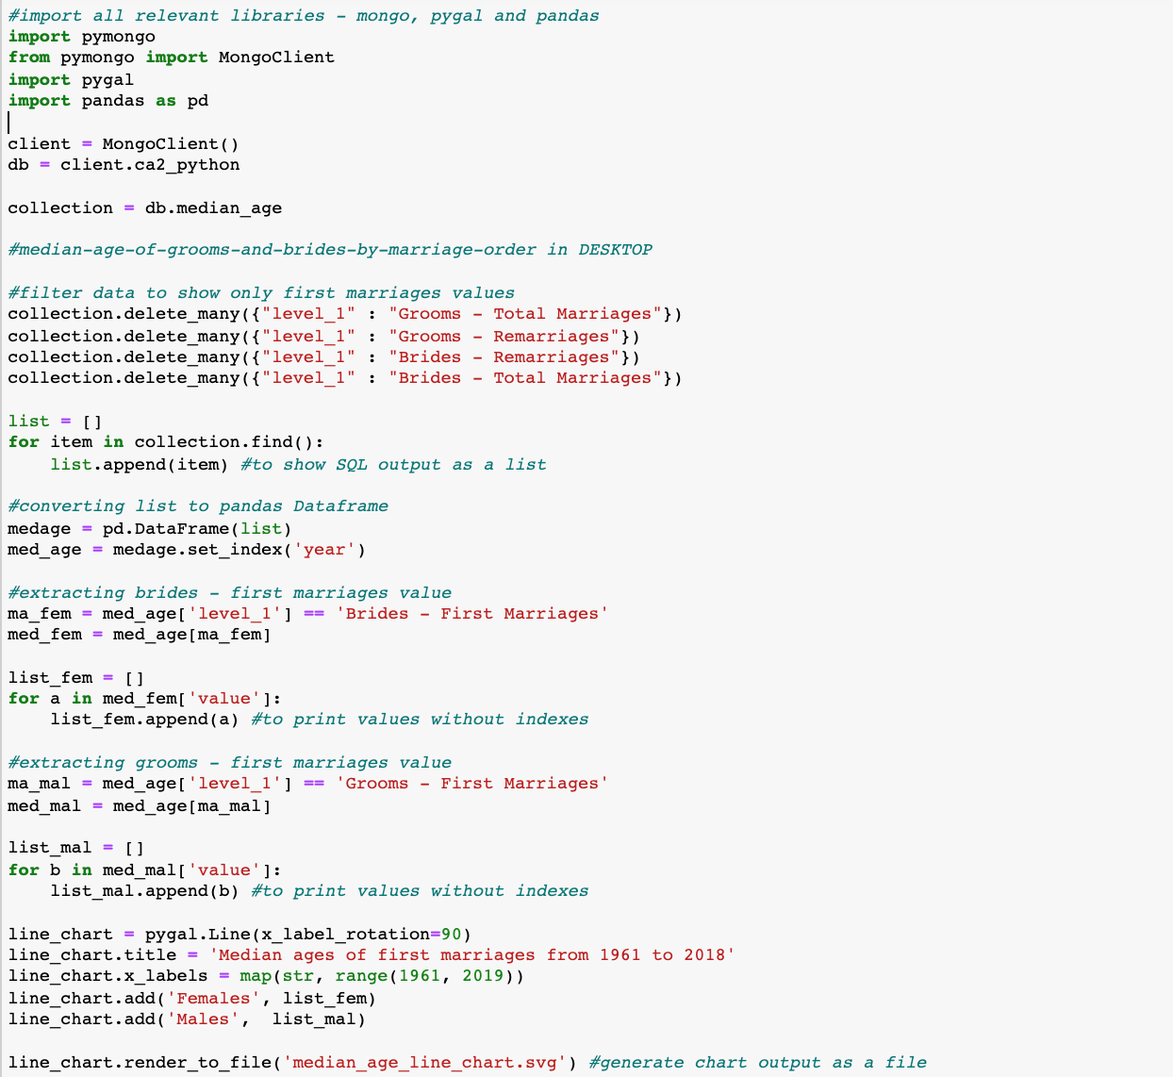
Median age of brides and grooms by Marriage Order
Step 1:
In the anaconda jupyter notebook window, import the relevant libraries – pymongo, pygal, pandas
Step 2:
Filter the irrelevant fields, leaving only the required fields for analysis – Brides & Grooms (first marriages)
Step 3:
Populate the values as a list in python
Step 4:
Generating the pygal chart and exporting the output
Step 1
Step 2
Step 3
Step 4

Slide 8
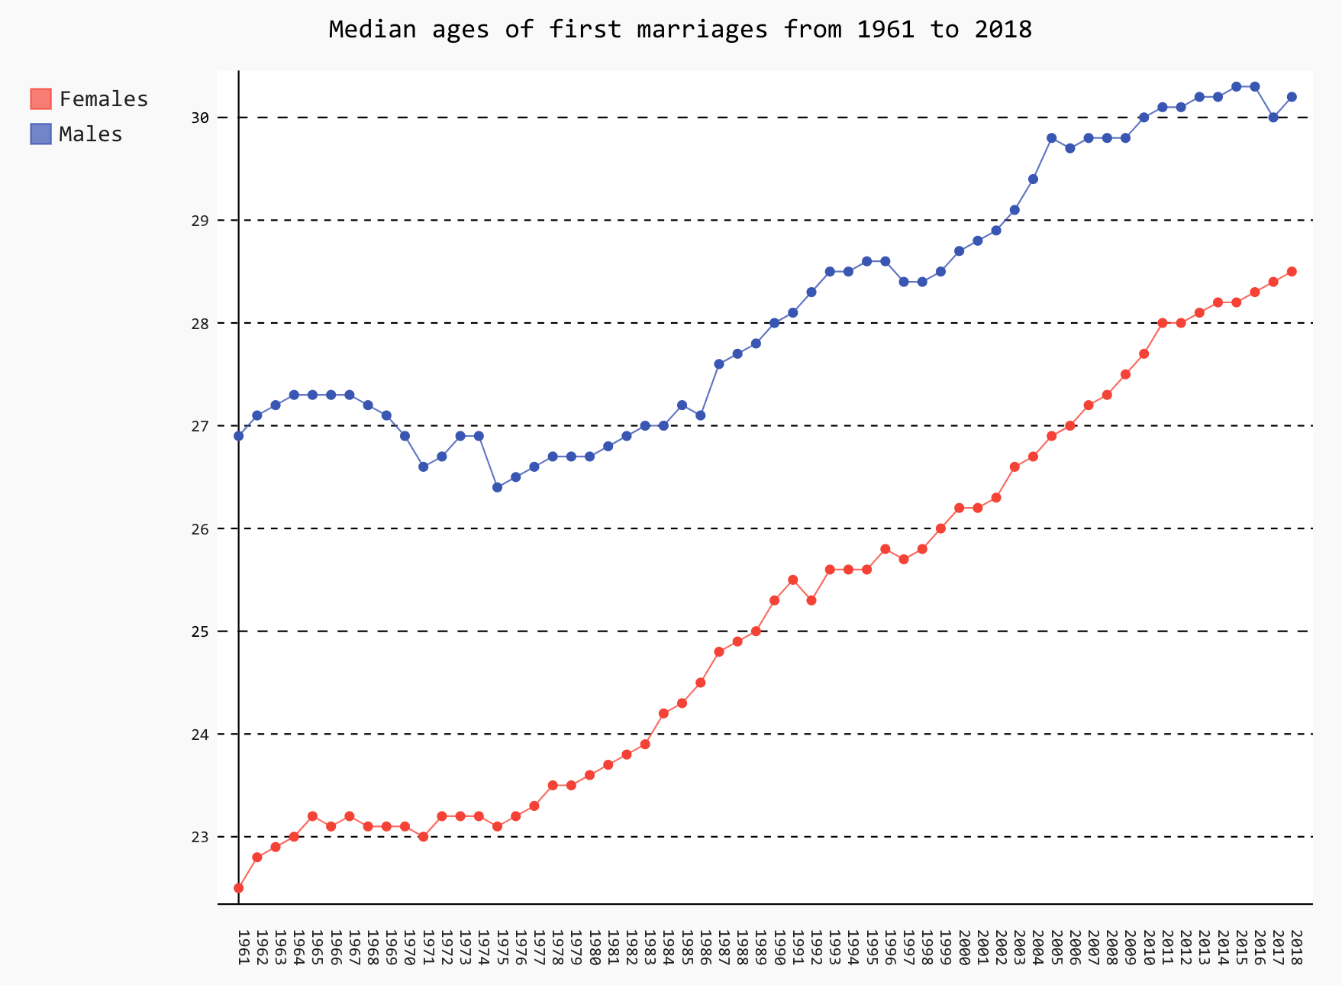
Median age of brides and grooms by Marriage Order – Pygal chart
An obvious upward increase trend in median ages of first marriages for both males and females from 1961 to 2018
In 1961, median ages of first marriages were as below:
Woman: 22.5
Man: 26.9
In 2018, median ages of first marriages were as below:
Woman: 28.5
Man: 30.5

Slide 9

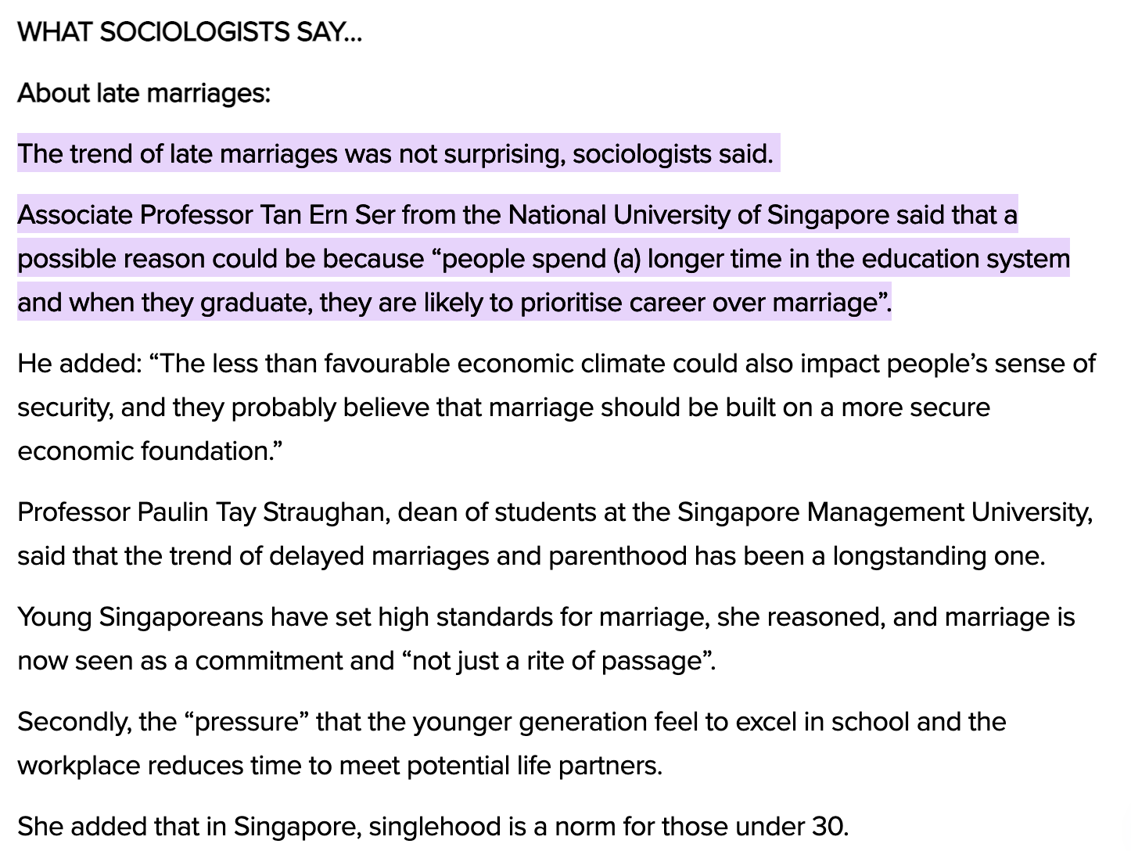
Why are Singaporeans choosing to marry later over the years?
Source: https://www.todayonline.com/singapore/couples-singapore-getting-married-later-fewer-getting-divorced#:~:text=The%20trend%20of%20late%20marriages,to%20prioritise%20career%20over%20marriage%E2%80%9D.

Slide 10
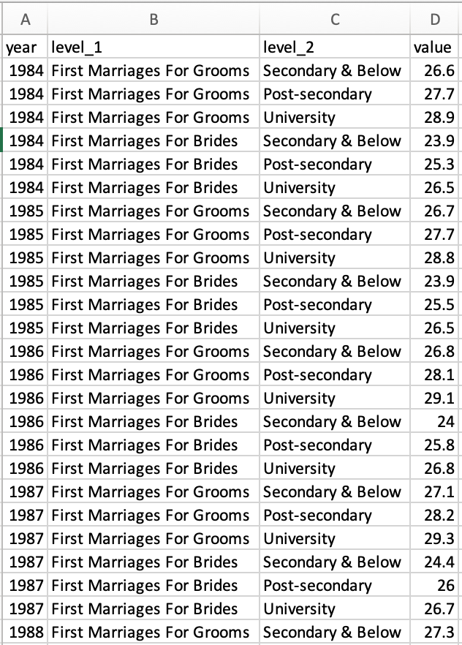
Median Age at First Marriage of Grooms and Brides by Educational Qualification, Annual
Link: https://data.gov.sg/dataset/median-age-at-first-marriage-of-grooms-and-brides-by-educational-qualification-annual?resource_id=e25a47ed-a41f-410e-b947-a4e30c1b308e

Slide 11
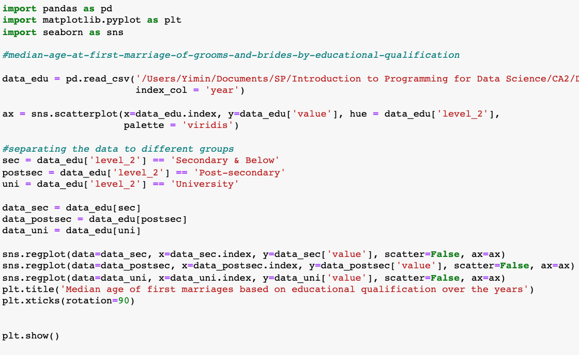
Median Age at First Marriage of Grooms and Brides by Educational Qualification, Annual
Step 1:
Import the relevant libraries – Pandas, matplotlib & seaborn, and import the data using pandas
Step 2:
Plotting the scatterplot for all the values given in the data, from year 1984 till 2018
Step 3:
Reorganizing the data and sub-grouping them based on their educational qualification – 1) Secondary & below, 2) Post-secondary and 3) University
Step 4:
Plotting the best fit line for the scatterplot points using regplot
Step 1
Step 2
Step 3
Step 4

Slide 12
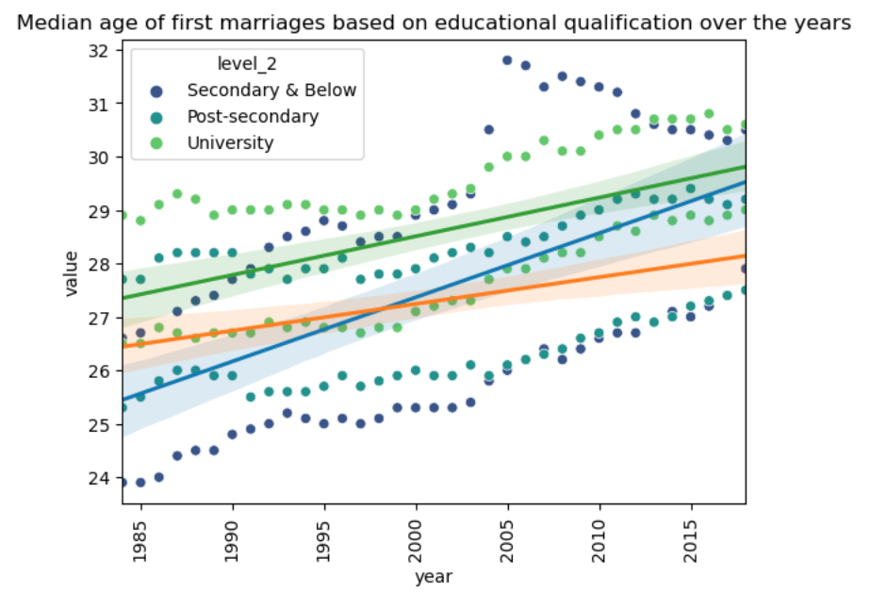
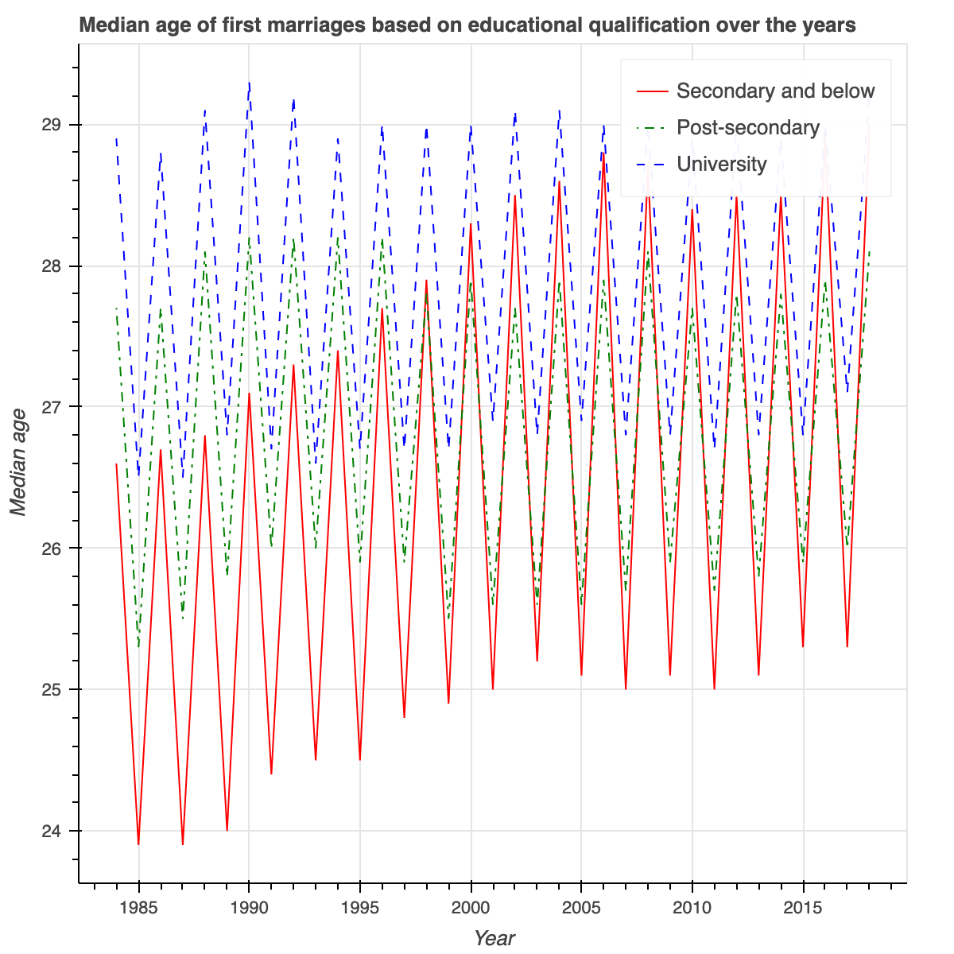
Median Age at First Marriage of Grooms and Brides by Educational Qualification, Annual
Seaborn
Bokeh
An obvious upward in trend, regardless of their educational qualification levels, as proven by their best-fit lines

Slide 13
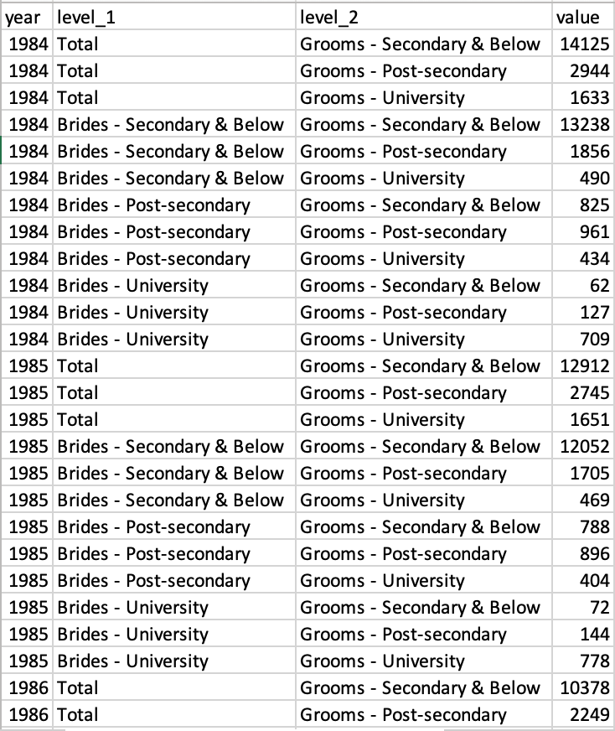
total number of marriages by educational qualifications - grooms
Link: https://data.gov.sg/dataset/first-marriages-couples-under-women-s-charter-educational-qualification-brides-grooms-annual?resource_id=7331cfb7-051f-4e25-937a-46d47f5ecf7e (Grooms)
https://data.gov.sg/dataset/first-marriages-couples-under-women-s-charter-educational-qualification-brides-grooms-annual (Brides)

Slide 14
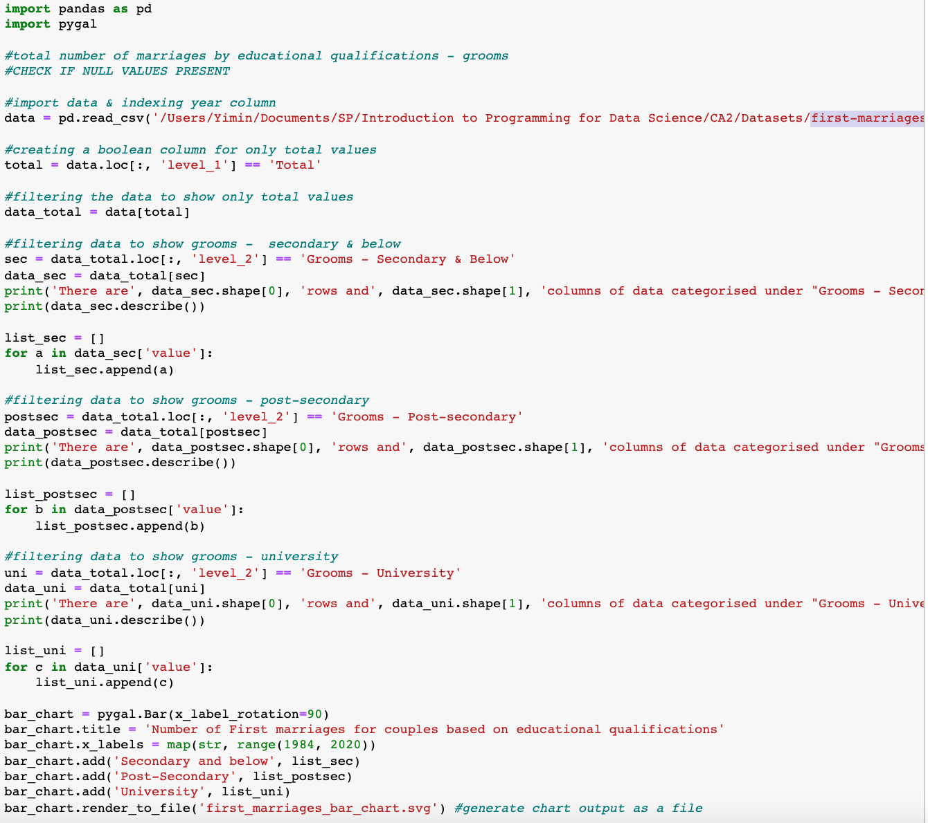
total number of marriages by educational qualifications - grooms
Step 1:
Import the relevant libraries – Pandas, matplotlib & seaborn, and import the data using pandas
Step 2:
Filter the total values to show only total values in the dataset
Step 1
Step 2

Slide 15
total number of marriages by educational qualifications - grooms
Step 3:
Reorganizing the data and sub-grouping them based on their educational qualification – 1) Secondary & below, 2) Post-secondary and 3) University
Step 3
Step 3
Step 4

Slide 16
total number of marriages by educational qualifications - grooms
Step 4:
Using Pygal to generate the bar chart
Step 4

Slide 17
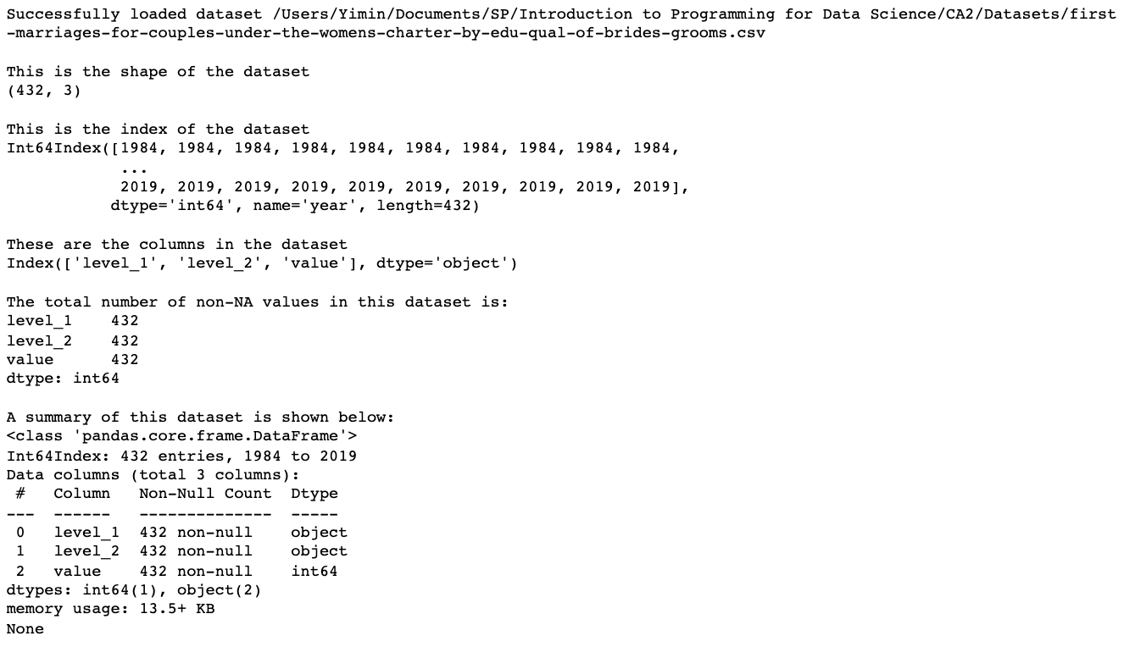
Summary of data & its statistics

Slide 18
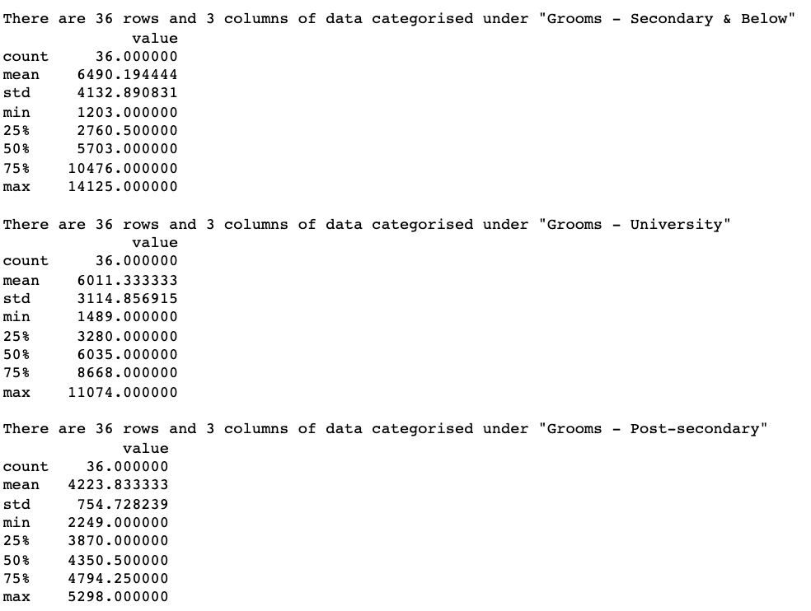
Summary of data & its statistics

Slide 19
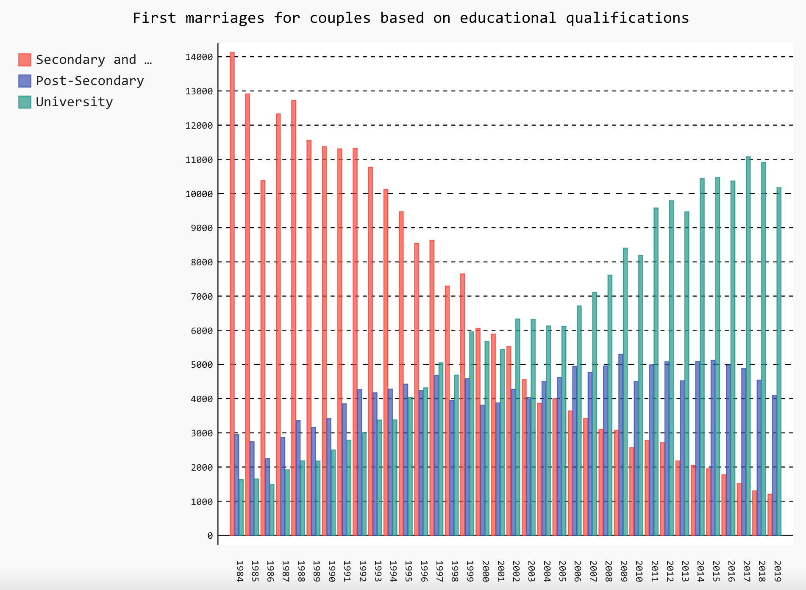
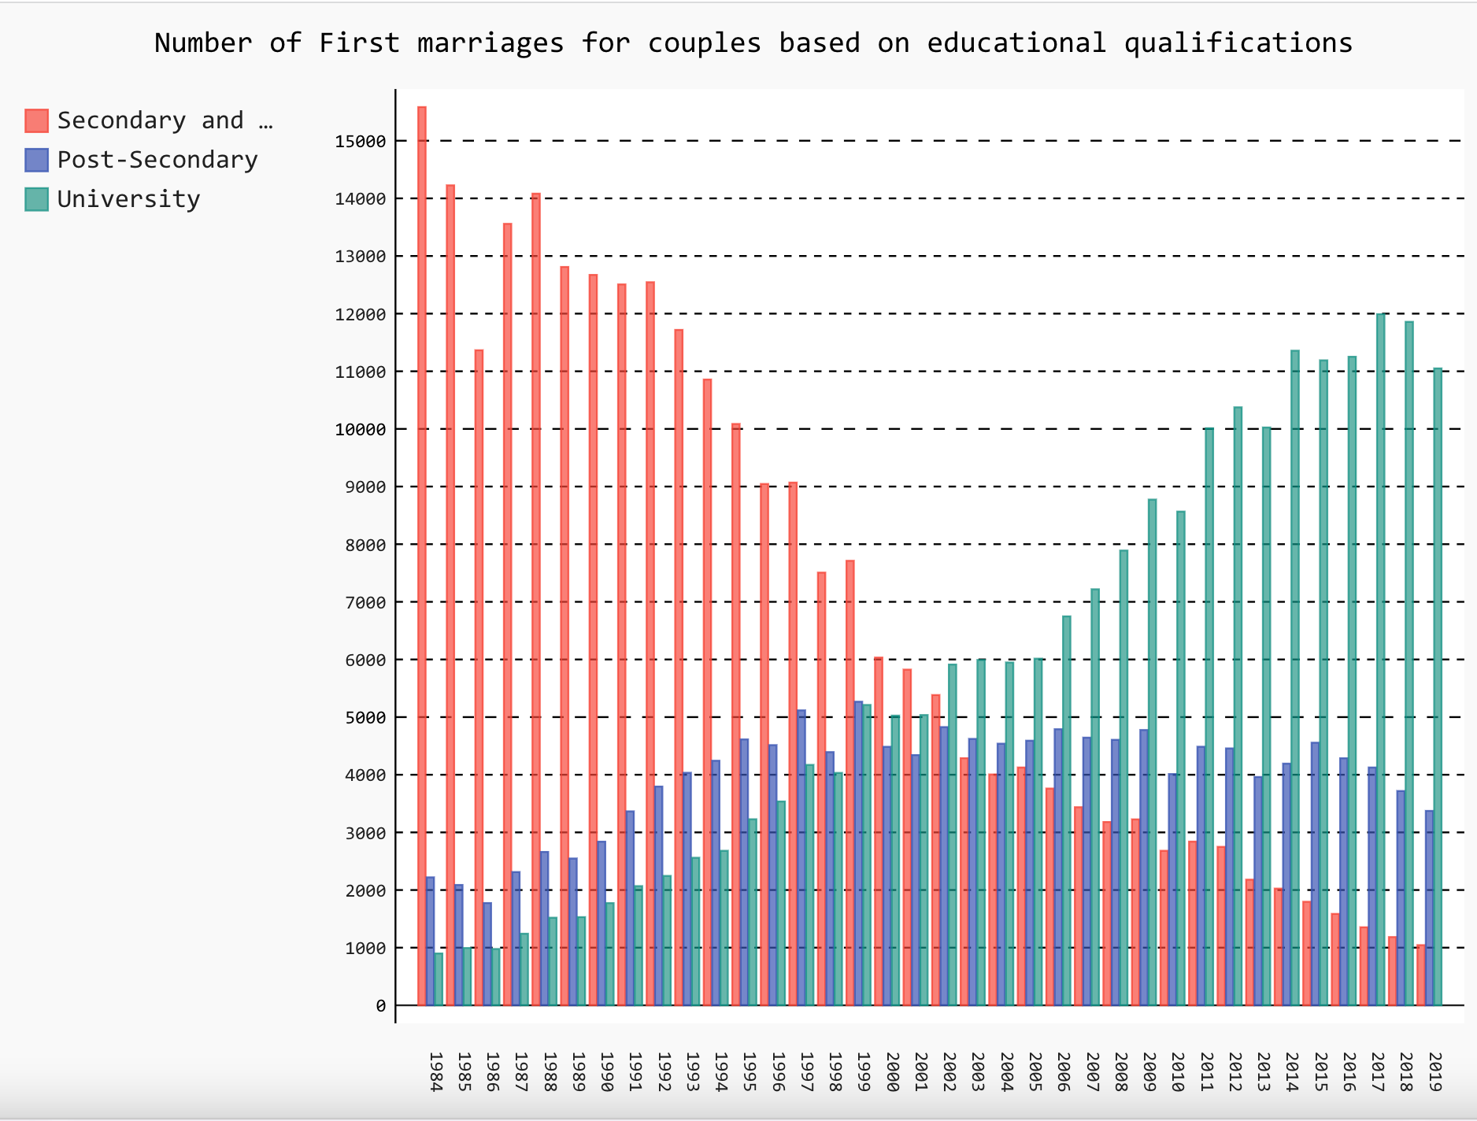
total number of marriages by educational qualifications – grooms & brides
Grooms
Brides

Slide 20
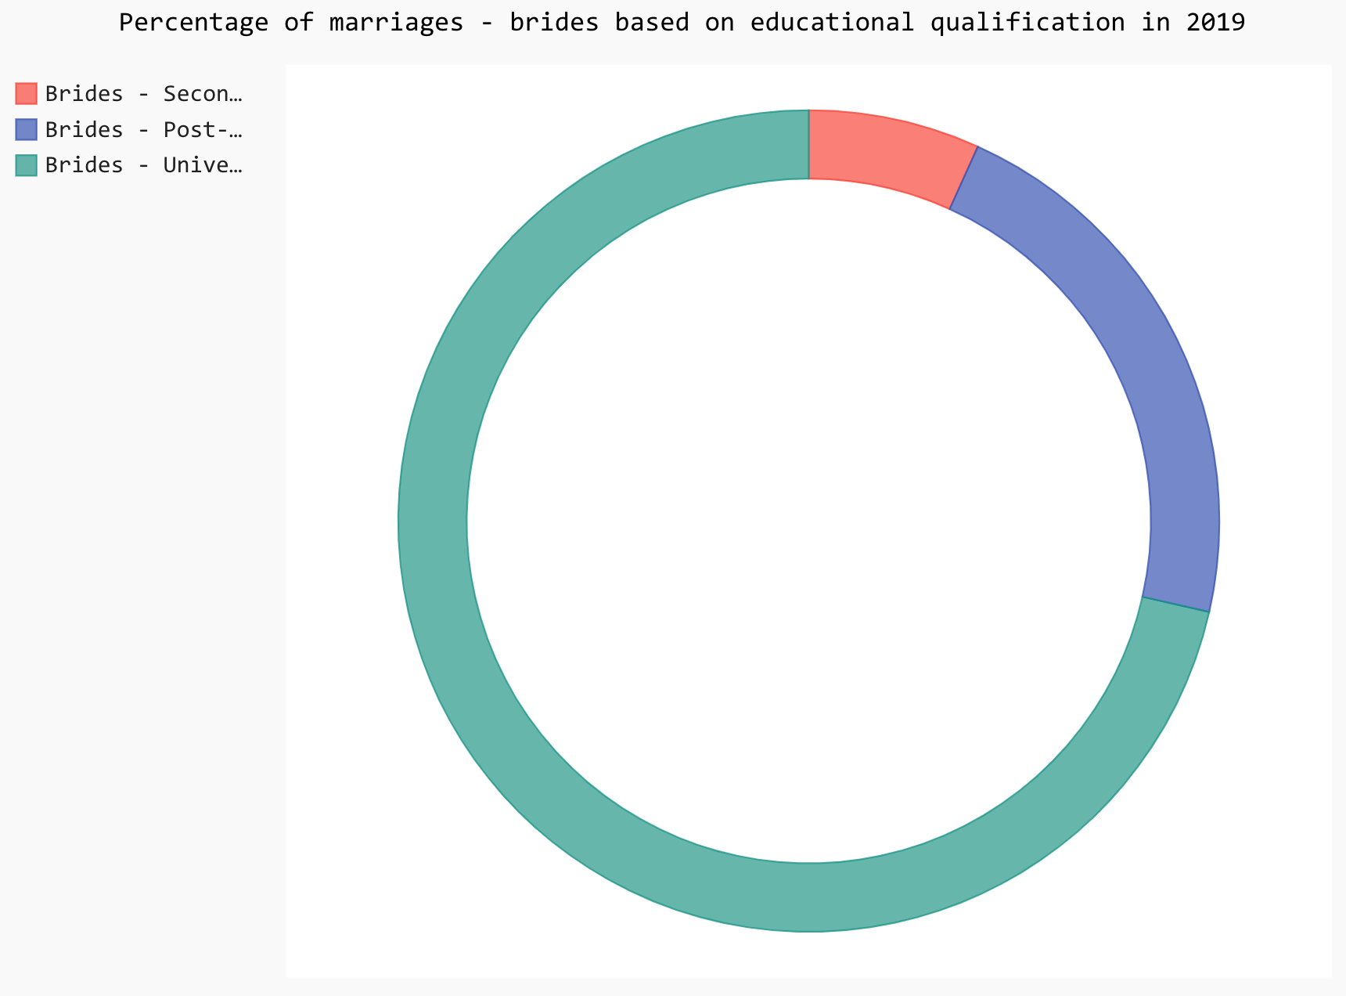
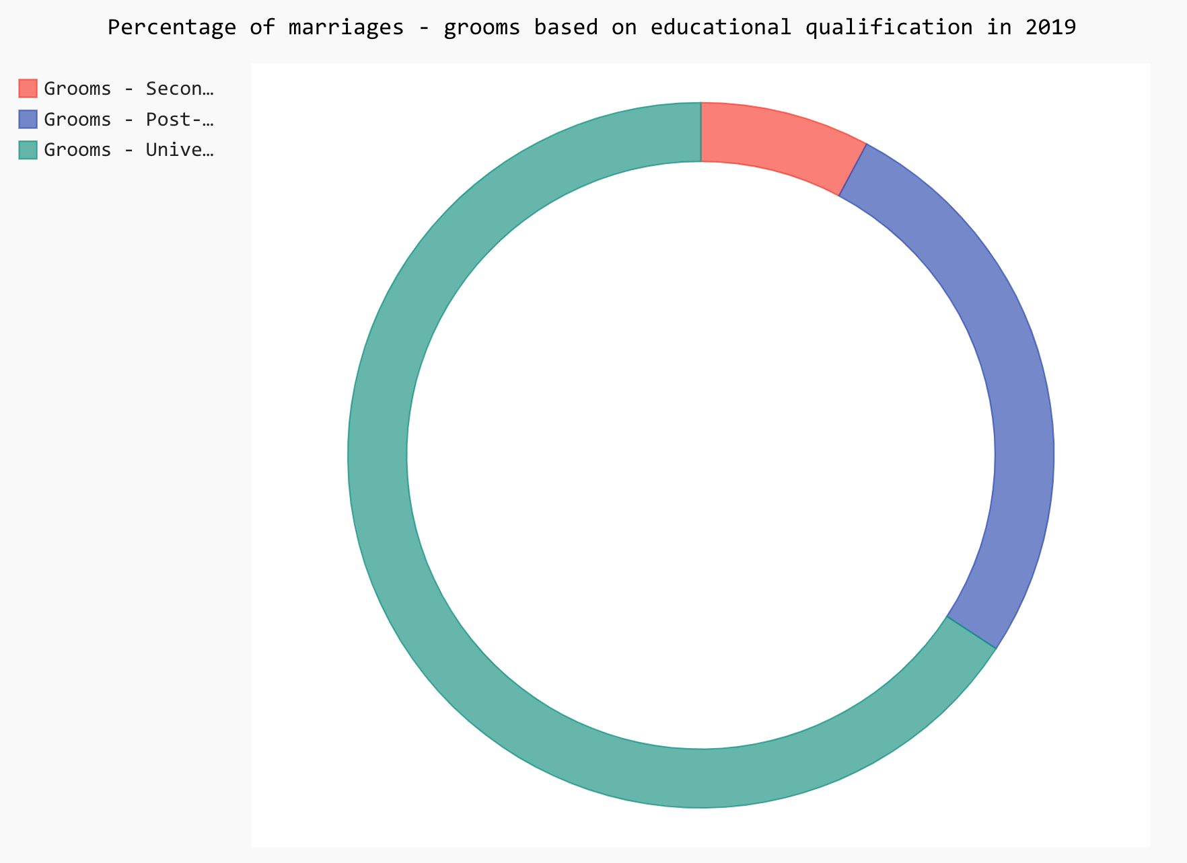
total number of marriages by educational qualifications – grooms & brides in 2019
GROOMS
BRIDES

Slide 21

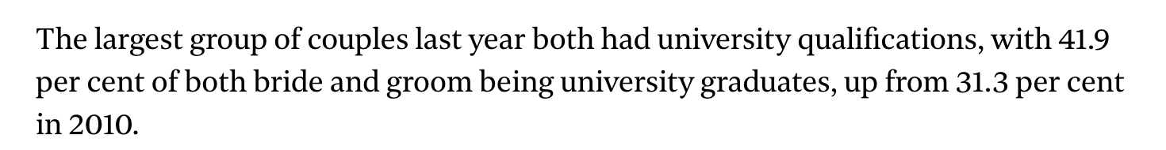
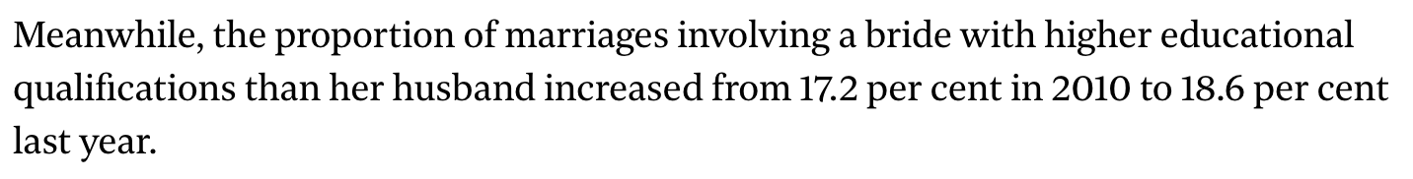
total number of marriages by educational qualifications – grooms & brides
Source: https://www.straitstimes.com/singapore/community/traditional-norms-of-age-and-education-in-marriages-changing-with-time#:~:text=SINGAPORE%20%2D%20In%20marriage%2C%20the%20preference,17.9%20per%20cent%20last%20year.

Slide 22
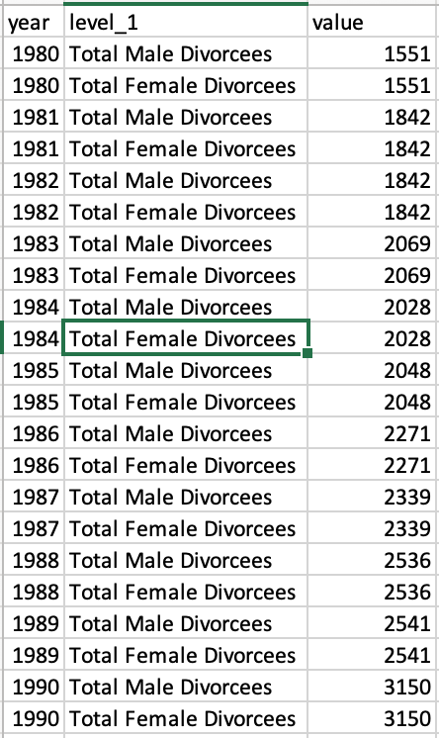
Number of divorces from 1981 to 2020
Link: https://data.gov.sg/dataset/total-divorces-by-sex-and-age-group-of-divorcees-annual?resource_id=1d443653-df08-4e39-892b-fc198de883be
Notes:
https://www.todayonline.com/singapore/fall-singapore-marriages-divorces-2020-amid-covid-19-restrictions-uncertainty

Slide 23
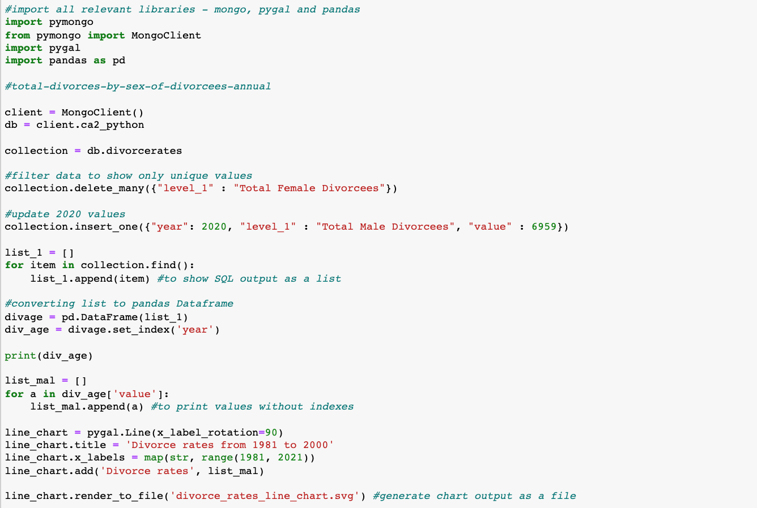
Number of divorces from 1981 to 2020
Step 1:
Importing dataset (in csv) into MongoDB terminal, by first launching the MongoDB terminal and create a database in the MongoDB terminal
Update 2019 divorce rates using MongoDB
Step 2:
Importing the relevant libraries – pandas, pygal, pymongo in Python, and its database.
Step 1
Step 2

Slide 24
Number of divorces from 1981 to 2020
Delete duplicate values by deleting rows containing ‘Total female divorcees’, and updating 2020 divorce rates values
Step 3:
Converting data given into pandas dataframe, and creating a list for all values for the data given
Step 4
Generating all values into pygal line chart and saving output as svg file
Step 2
Step 3
Step 4

Slide 25
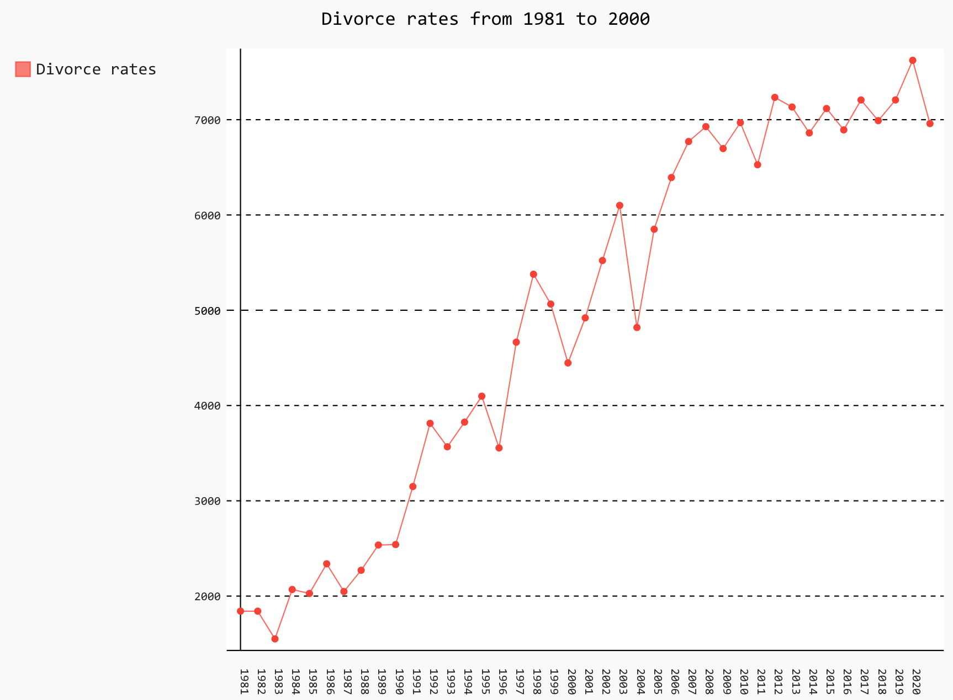
Number of divorces from 1981 to 2020

Slide 26
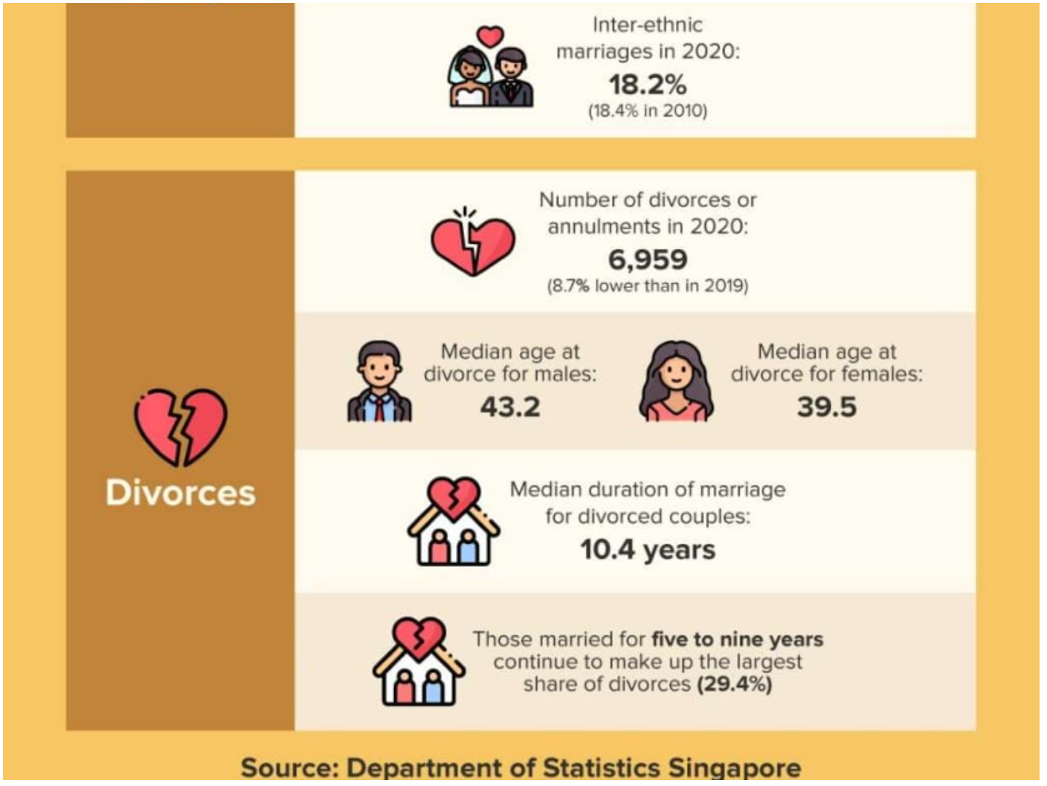
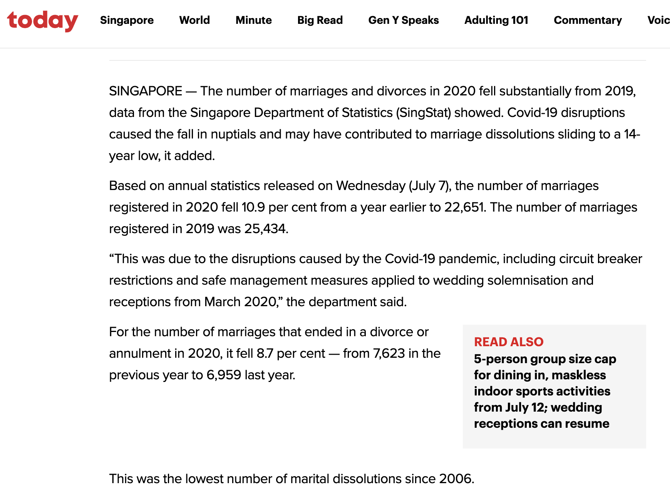
Analysis of 2020’s divorce rates

Slide 27
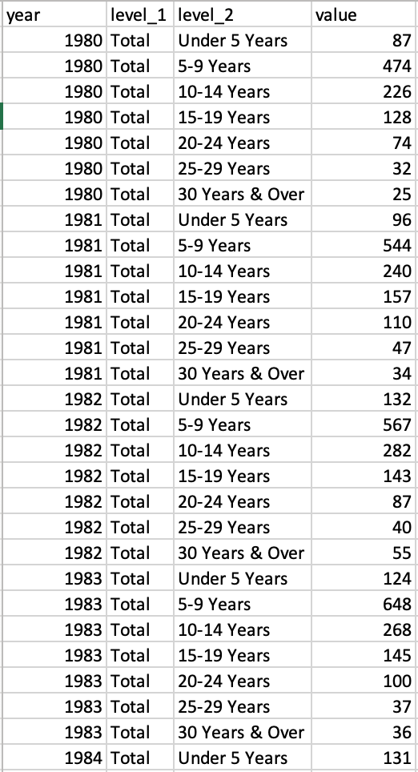
Number of divorces by duration of marriage
Link: https://data.gov.sg/dataset/divorces-under-the-women-s-charter-by-duration-of-marriage-annual?resource_id=a02fa1ab-f3c0-4615-9a5a-1c975e4e6d98

Slide 28
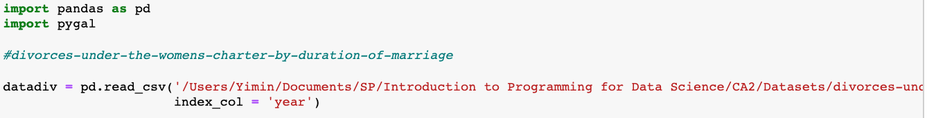
Number of divorces by duration of marriage
Step 1:
Importing the relevant libraries – pandas, pygal in Python, and its data using pandas.
Step 1

Slide 29
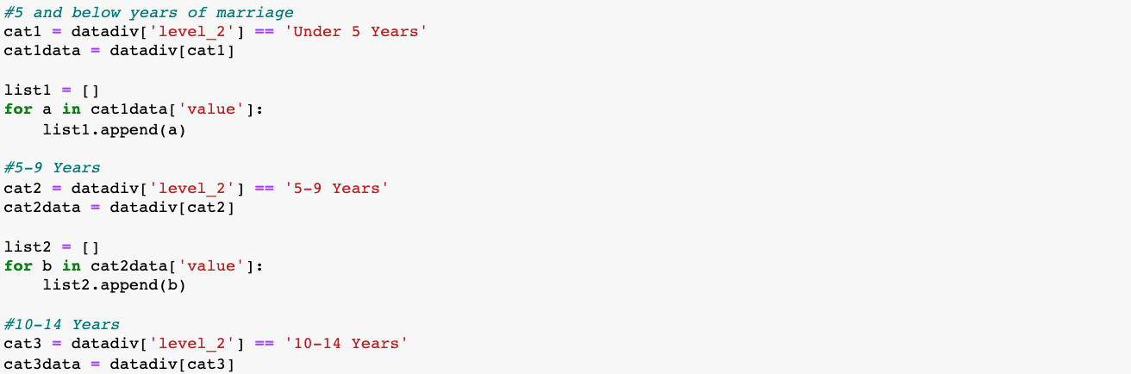
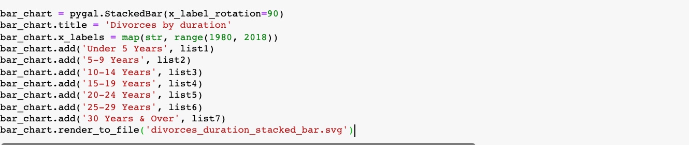
Number of divorces by duration of marriage
Step 2:
Subgroup all values of different durations of divorces into various lists
Step 3:
Generating all values into pygal line chart and saving output as svg file
Step 2
Step 3

Slide 30
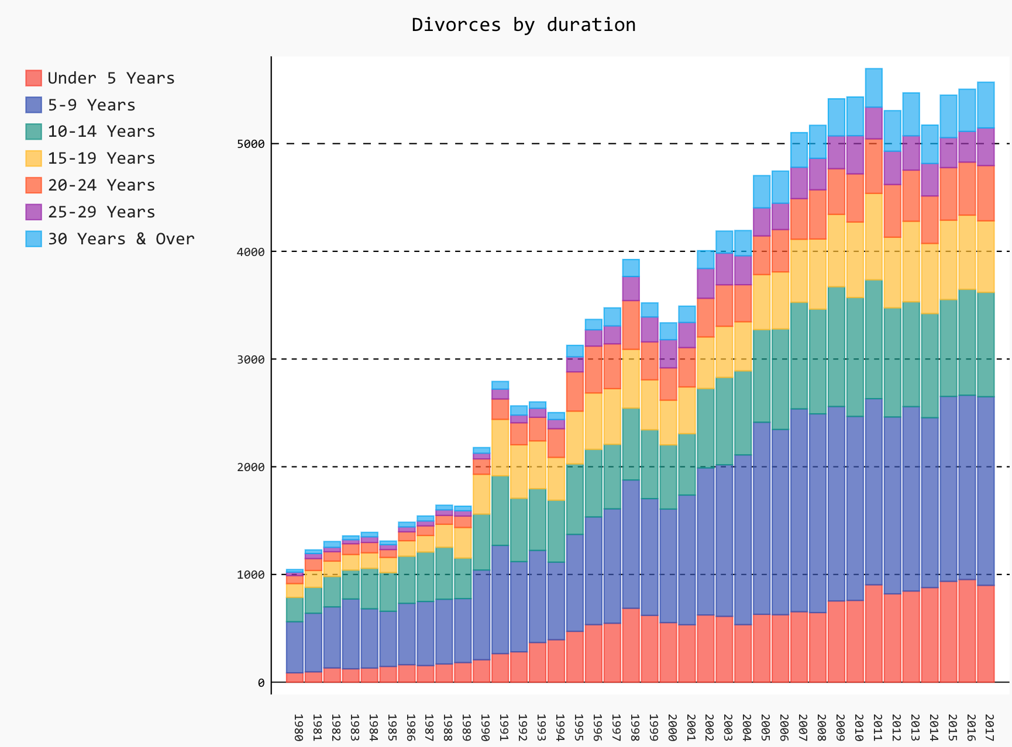
Number of divorces by duration of marriage
Notes:
Min divorce duration, max divorce duration

Slide 31
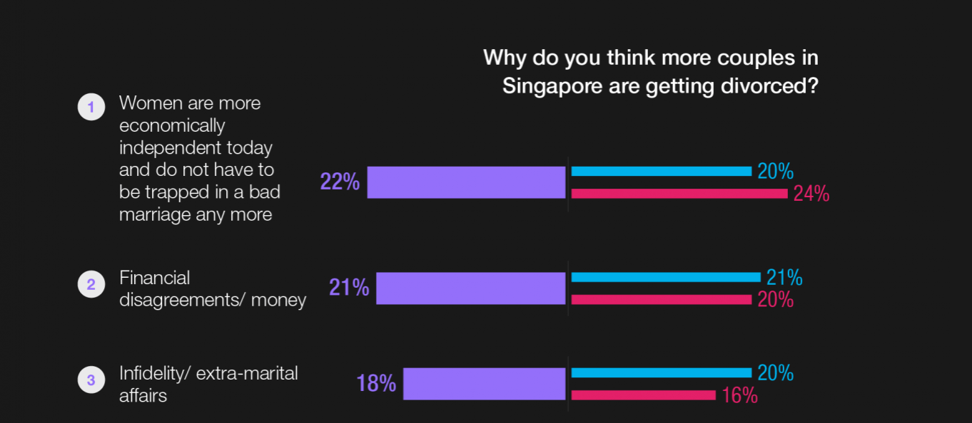

Reasons for rising divorce rates (top 3)
Source: https://blackbox.com.sg/everyone/honey-you-can-have-him-rising-divorce-in-singapore

Slide 32
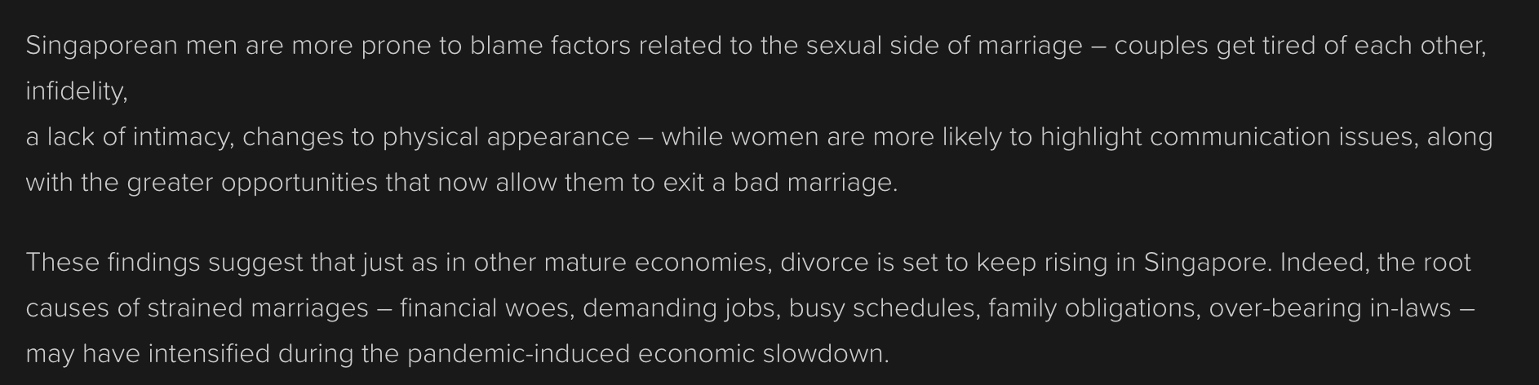
Reasons for rising divorce rates
Source: https://blackbox.com.sg/everyone/honey-you-can-have-him-rising-divorce-in-singapore

Slide 33
END

